Slide 1

Group 9
Michael Allen, Joel Alvarez, Mason Inman, Erin Roach
Notes:
Erin

Slide 2
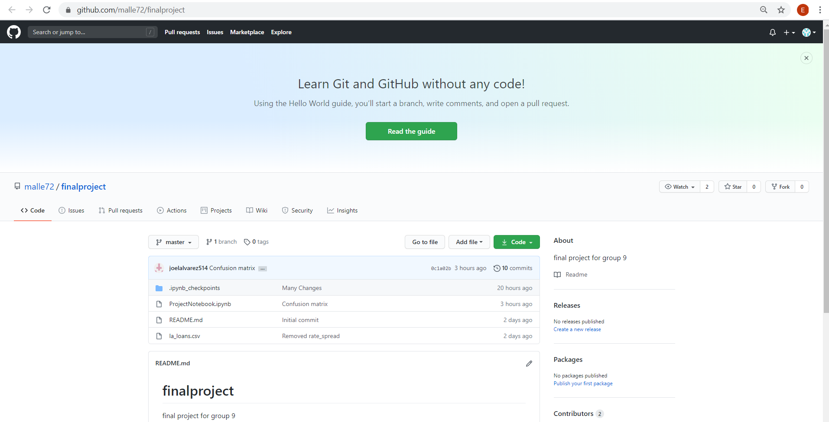
Git Repository
https://github.com/malle72/finalproject
Notes:
Erin

Slide 3
Success
To measure success our model will validate (within .03) and beat the naive rule (0.55).
The intended use for this algorithm would be a loan officer having the ability to expedite the loan approval process.
⯀Another use for this algorithm could be to help remove bias from the loan application review process.
Notes:
Erin

Slide 4
Assumptions
The records that had the value “loan purchased by institution” were not valid or were going to cause problems and we could not define it as a definite loan accepted.
This reduced our observations by about 24,000. The final observation count is around 148,000.
If this model is to be used to make good recommendations to a loan officer, we have to assume that the source data only contains good choices.
Notes:
michael

Slide 5
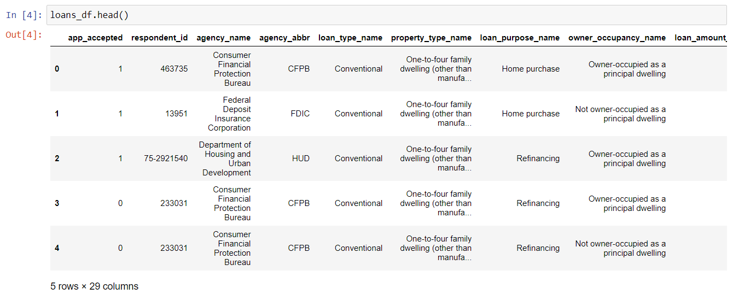
Dataset
https://www.consumerfinance.gov/
Every housing loan for which someone applied in Louisiana in 2017.
The original data set features: 7 floats, 3 integers, 19 objects
Notes:
michael

Slide 6
Train and Test dataset
# code to split data into training and testing
x_train, x_test, y_train, y_test = train_test_split(loans_df[loans_df.columns[1:]],loans_df.app_accepted,test_size=0.2, random_state=9,stratify=loans_df.app_accepted)
Training: 80%
Testing: 20%
Notes:
michael

Slide 7
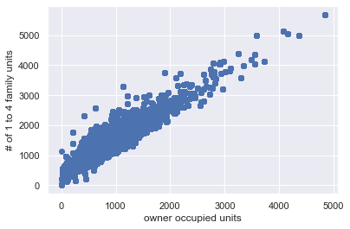
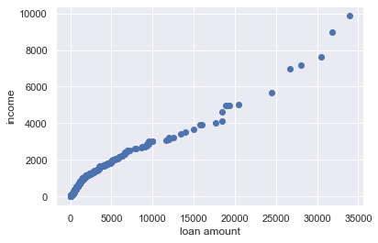
Visualize Data
These scatter plot visualizations serve as examples of multicollinearity between variables in our model
Notes:
Speaker: Mason I.

Slide 8
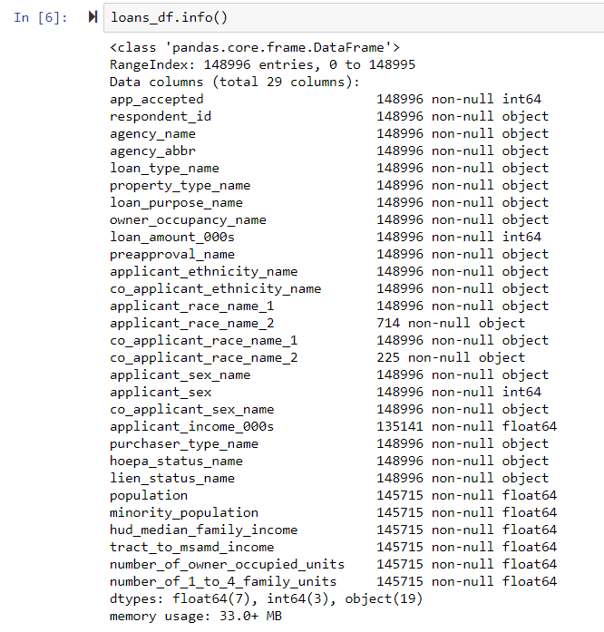
Identify Target Features
Response Variable: app_accepted
Computed from Action Taken
“Loan Originated” = 1
Other values = 0
Dropped: respondent_id (not needed), agency_name (duplicate feature)
All other input variables were used in the model
Notes:
Speaker: Mason I.

Slide 9
Inspect & Wrangle Data
Cleanliness of data:
The data was clean, but not all variables were in the formats that our model required
There were missing numeric values in the census data and missing data for categorical fields
Wrangling Data:
Looped through all of the census numeric variables to replace NaN values with the median value
Replaced empty values in applicant_income_000s with median value
Did not remove any outliers
Useless Features:
Dropped respondent_id because it is not needed, dropped agency_name because it was a duplicate feature
Object variable issue:
Created dummy variables for all categorical variables for use in decision tree
Notes:
Speaker(s): Mason I. (and maybe random)

Slide 10
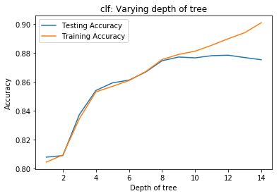
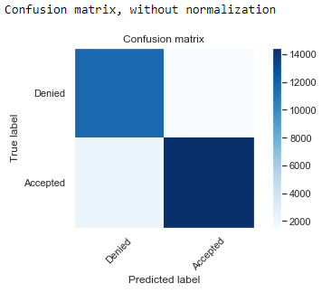
Identifying & Testing Model
Decision Tree:
Training score = .8790
Testing score = .8772
Confusion Matrix
Note: Naive rule = .5592
Decision tree validates and beats the Naive rule.
Notes:
joel

Slide 11
Interesting Facts/ Lessons Learned
The random forest model produced worse results than the decision tree of the same depth.
By increasing the max depth on our random forest we got a better scores but still not as good as decision tree.
Random Forest score = .6621
MSE = .0801
R^2 = .6750
Random Forest can potentially run into problems with dummy variables and since we created several dummy variables this might be an explanation as to why the Random Forest model produced weak results.
Notes:
joel

Slide 12
END
Thank you for your time!

